Slide 1
Emerging Transportation Technologies: Connected and Autonomous Vehicle Technology
CETL-8713
Somdut Roy
Notes:
Hello
Today I will be giving an introductory overview on a very hot topic in transportation field. I will be talking about the technology that drives autonomous vehicles

Slide 2

About Me
PhD Student at Transportation Engineering (CEE)
MS in Computational Science and Engineering (2019)
Research interests: Smart Cities, Autonomous and Connected Vehicle Technology
Notes:
Briefly about me, I am doing my PhD in transportation Engineering under Civil and Environmental Engineering Home. I had my masters in CSE.
Using my experiences, I have worked on several smart city projects and I will be introducing some terms related to the basics of Connected and Autonomous vehicle technologies.

Slide 3
Class Purpose
Introduce the concepts and state of Emerging Technologies
Autonomous vehicle (AV) technology
Levels of automation
Connected vehicle (CV) technology
Types of connections
Features of this technology
Notes:
We will be going over two primary technologies that will drive autonomous vehicles in tandem with manually driven vehicles,
on one side, we have autonomous vehicle technology
And, connected vehicle technology

Slide 4
Class Purpose
Introduce the concepts and state of Emerging Technologies
Autonomous vehicle (AV) technology
Levels of automation
Connected vehicle (CV) technology
Types of connections
Features of this technology
Connected Automated vehicle(CAV) technology
Notes:
Together, they form what we call the Connected automated vehicle technology or CAV.
*pause*

Slide 5
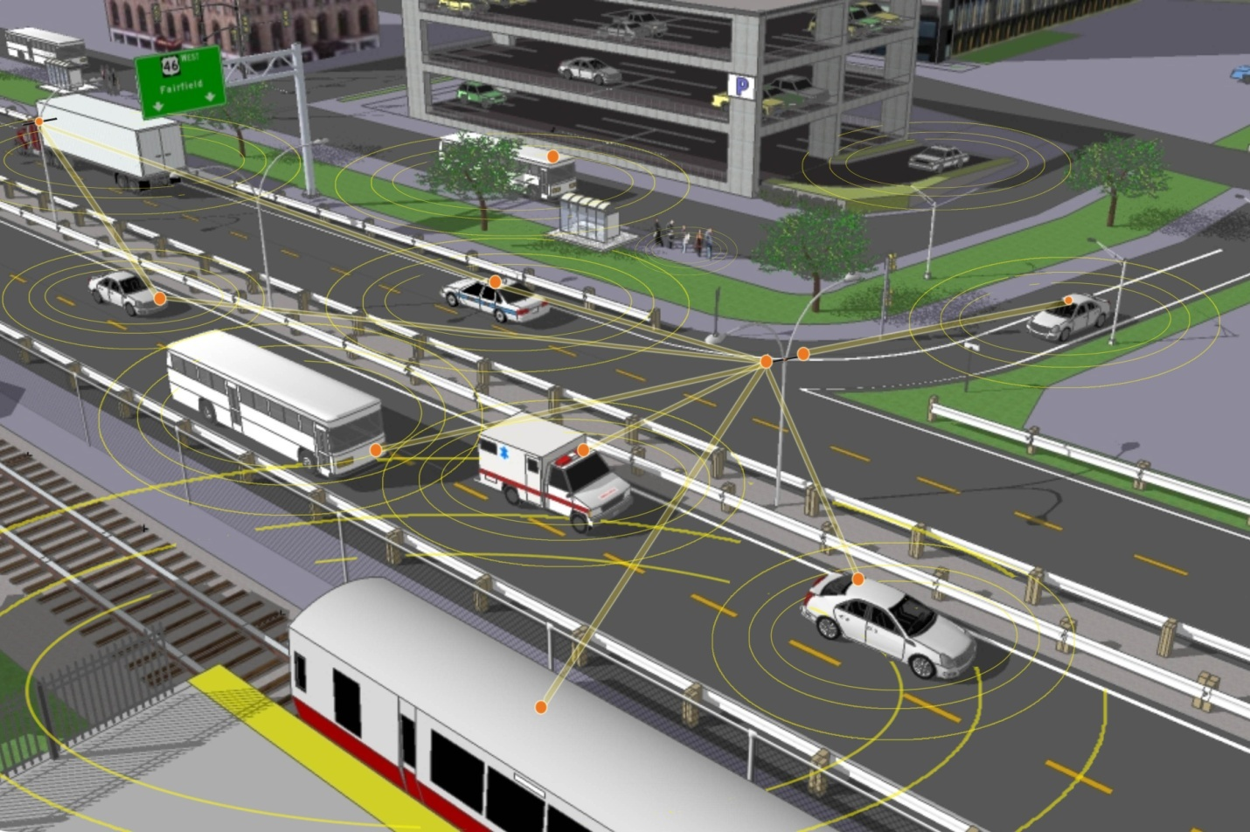
What do we mean by Emerging technologies?
Connected Automated Vehicles
Smart Cities: A controlled environment that uses these features
Mobility as a Service: Different ride-hailing services: Lyft, Uber; how they fall in the “smart” ecosystem
Big Data: Use of high-volume data (~TB) in real time from multiple sources to make the smart city functions possible

Slide 6
What do we mean by Emerging technologies?
Connected Automated Vehicles
Smart Cities: A controlled environment that uses these features
Mobility as a Service: Different ride-hailing services: Lyft, Uber; how they fall in the “smart” ecosystem
Big Data: Use of high-volume data (~TB) in real time from multiple sources to make the smart city functions possible

Slide 7
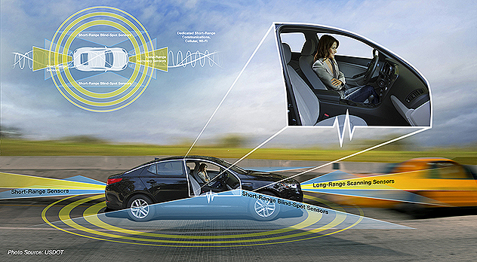
What are Autonomous Vehicles (AV)?
Automated vehicles use on-board sensors, cameras, global positioning, and telecommunications to help perform safety-critical driving functions such as steering, acceleration and braking - without direct driver input
Automated does not always mean self-driving
Notes:
Talking about one half of the lecture.
Autonomous vehicle
It would be a vehicle that would have the capability to make decisions like accelerating, braking, positioning and steering without actual human output.
Automated may not mean self driving necessarily and we will get to it in the next exercise.

Slide 8
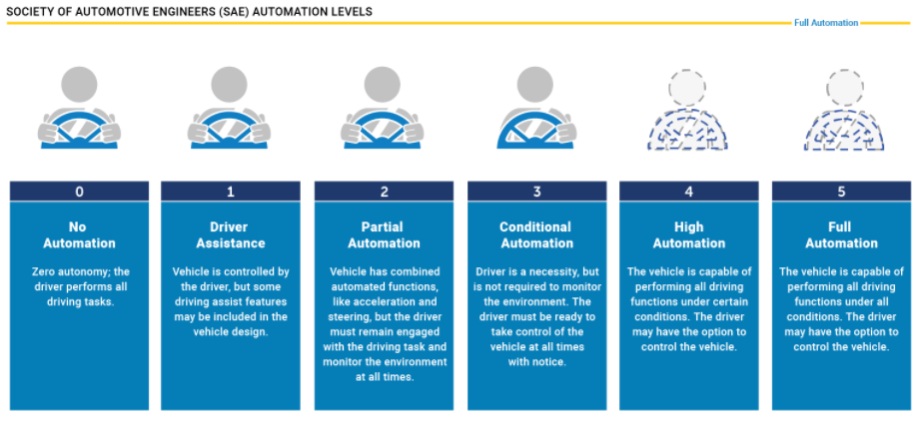
Levels of Vehicle Automation
Notes:
Broadly speaking, there are 5 levels of automation.
Level 1 is basically the most non-automated one, where the driving does all the task.
On the next level, we have some added features that you can find in almost all cars manufactured in recent times.
Then we go to level 3, a texting while driving level, if you want to call it that, where we need the driver, but the car itself is able to make decision at most times.
Then we get to the next level, one could do anything they want while the car does its job at most times.
And on to the final level, the car has the ability to do anything.
The common thing about all the levels is that a driver could always have the option to take control. *Pause*

Slide 9
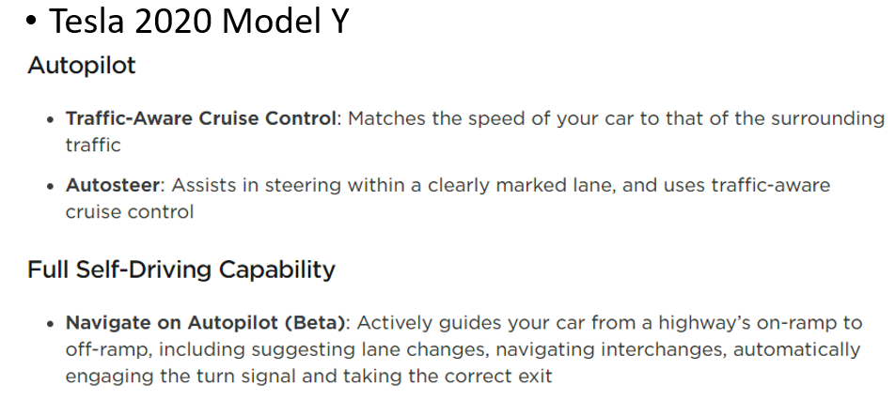
Levels of Vehicle Automation
Notes:
Going on a quick exercise, on the top left is a tesla model Y, with some self driving capability. Where do you think it falls?

Slide 10
Levels of Vehicle Automation

Slide 11
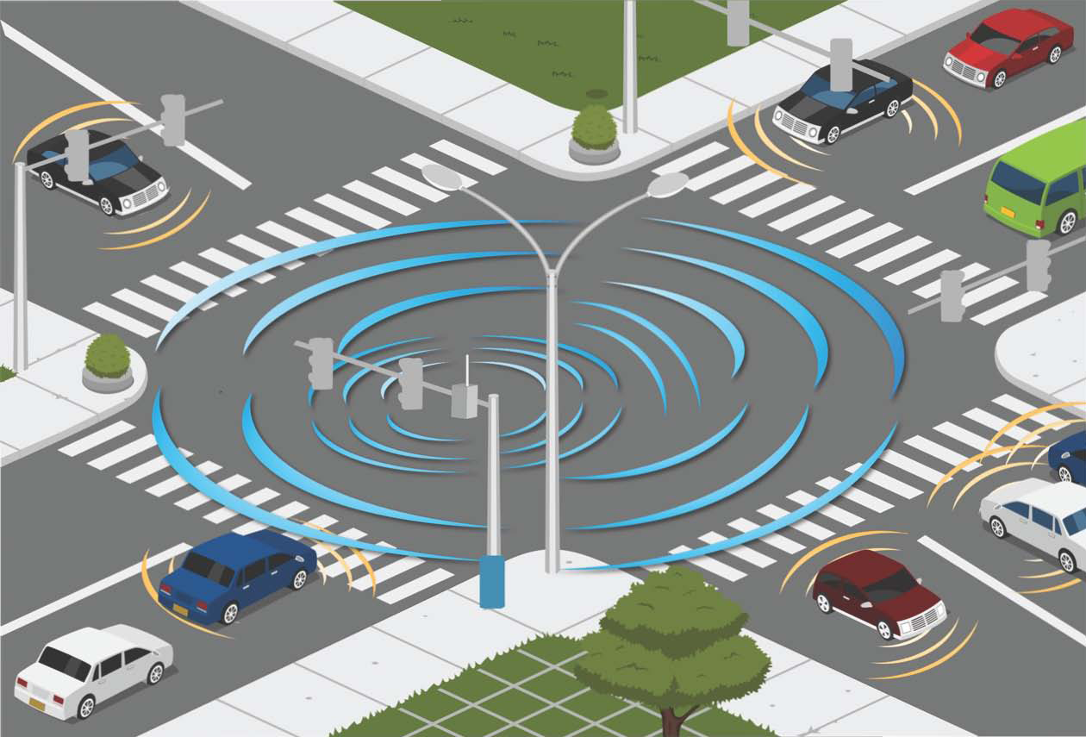
What are Connected Vehicles (CV)?
Wireless technology connecting vehicles to each other and to roadside infrastructure
Connections may be
Vehicle-to-Vehicle (V2V)
Vehicle-to-Infrastructure (V2I)
Vehicle-to-Other (V2X)

Slide 12
Types of Connections
Vehicle-to-Vehicle (V2V): looking for surrounding cars, avoid collision, follow cars efficiently
Vehicle-to-Infrastructure (V2I): be aware of surroundings, respond to signals and road features
Vehicle-to-Other (V2X): look for Collison hazards, road tolls, queue warnings
Relevant CV Applications
V2I Safety
V2X
V2V Safety

Slide 13

Types of Connections
Vehicle-to-Vehicle (V2V): looking for surrounding cars, avoid collision, follow cars efficiently
Vehicle-to-Infrastructure (V2I): be aware of surroundings, respond to signals and road features
Vehicle-to-Other (V2X): look for Collison hazards, road tolls, queue warnings
Red light violation warning
Motorist Advisories and warnings
Forward Collision warning
Curve Speed Warning
Relevant CV Applications
V2I Safety
V2X
V2V Safety

Slide 14
Types of Connections
Vehicle-to-Vehicle (V2V): looking for surrounding cars, avoid collision, follow cars efficiently
Vehicle-to-Infrastructure (V2I): be aware of surroundings, respond to signals and road features
Vehicle-to-Other (V2X): look for Collison hazards, road tolls, queue warnings
Motorist Advisories and warnings
Forward Collision warning
Curve Speed Warning
Relevant CV Applications
V2I Safety
Red light violation warning
V2X
V2V Safety

Slide 15
Types of Connections
Vehicle-to-Vehicle (V2V): looking for surrounding cars, avoid collision, follow cars efficiently
Vehicle-to-Infrastructure (V2I): be aware of surroundings, respond to signals and road features
Vehicle-to-Other (V2X): look for Collison hazards, road tolls, queue warnings
Forward Collision warning
Curve Speed Warning
Relevant CV Applications
V2I Safety
Red light violation warning
V2X
V2V Safety
Motorist Advisories and warnings

Slide 16
Types of Connections
Vehicle-to-Vehicle (V2V): looking for surrounding cars, avoid collision, follow cars efficiently
Vehicle-to-Infrastructure (V2I): be aware of surroundings, respond to signals and road features
Vehicle-to-Other (V2X): look for Collison hazards, road tolls, queue warnings
Curve Speed Warning
Relevant CV Applications
V2I Safety
Red light violation warning
V2X
V2V Safety
Forward Collision warning
Motorist Advisories and warnings

Slide 17
Types of Connections
Vehicle-to-Vehicle (V2V): looking for surrounding cars, avoid collision, follow cars efficiently
Vehicle-to-Infrastructure (V2I): be aware of surroundings, respond to signals and road features
Vehicle-to-Other (V2X): look for Collison hazards, road tolls, queue warnings
Relevant CV Applications
V2I Safety
Red light violation warning
V2X
Curve Speed Warning
V2V Safety
Forward Collision warning
Motorist Advisories and warnings

Slide 18
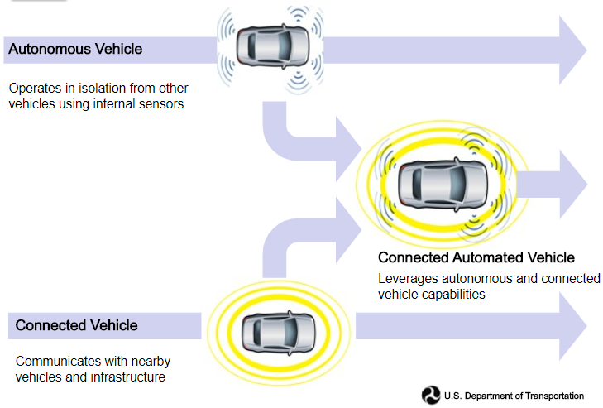
Summary: CAV = CV + AV
Notes:
In summary, we use the features from connected vehicle, where we have the necessary communications with the environment to have enough information to make self driving decisions.
On the other hand, we have the autonomous vehicle, that uses the information from connected vehicle technology and uses its own decision-making features to drive itself.
So, in tandem, we have the connected automated vehicle technology.
In the imaginary “next class”, we will talk more about how future smart cities will use these features.

Slide 19


